Slide 2
Training Objectives
Learn FEMA Damage Categories
Conduct an Initial Damage Report
Conduct a Building Assessment
View Assessments as part of a Damage Assessment Operation
Learn to Setup Device for Disconnected Use

Slide 3
1. Why Do Damage Assessments Matter?
Goal: to determine the Severity and Magnitude of a disaster to establish priorities for recovery and assess resource needs
Individual Assistance (Private, Uninsured Residences)
Public Assistance (Public Infrastructure and Labor Costs)
Small Business Administration (Commercial)
SBA Threshold: 25 structures above Major
PA Countywide Impact Threshold: County per capita threshold ($3.89)
IA Threshold: N/A

Slide 4
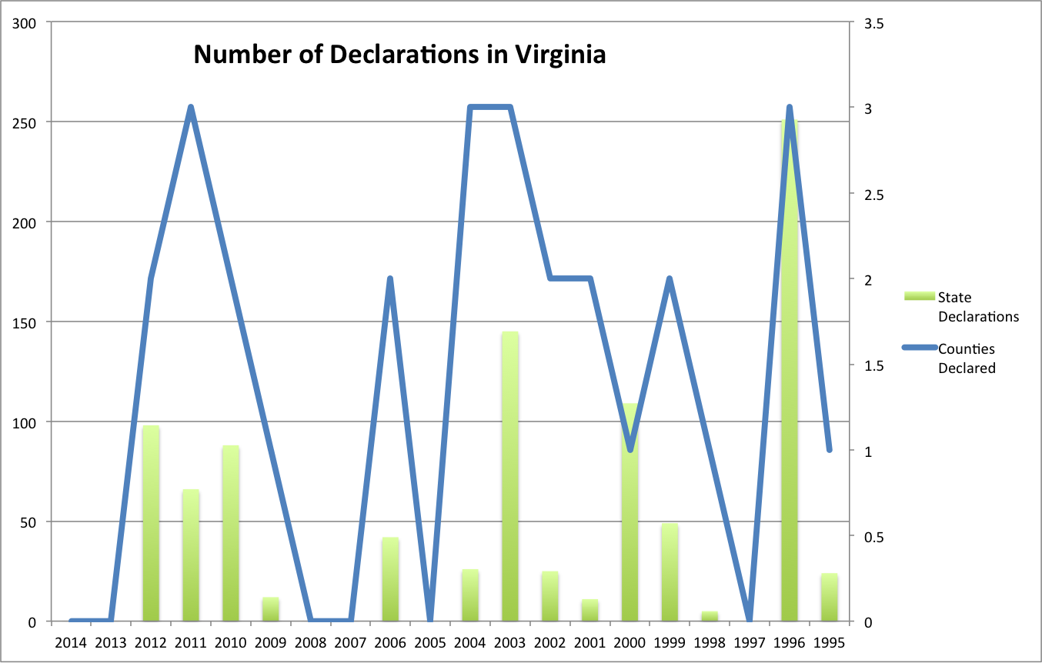
Declaration Frequency
Prince Edward
FEMA Declarations
1/13/1996
9/6/1996
2/28/2000
5/5/2002
9/18/2003
7/27/2012
Number of Declarations: 6 in 20 Years

Slide 5
FEMA Classifications
When in doubt, select higher category

Slide 6
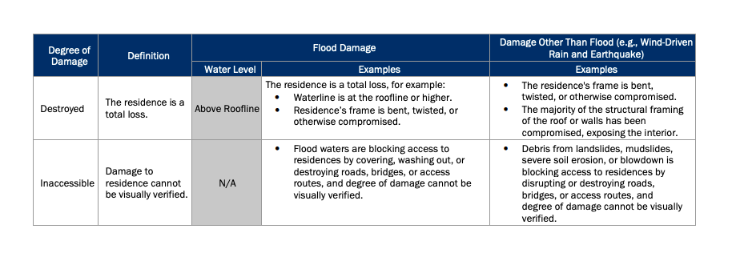
FEMA Classifications
When in doubt, select higher category

Slide 7
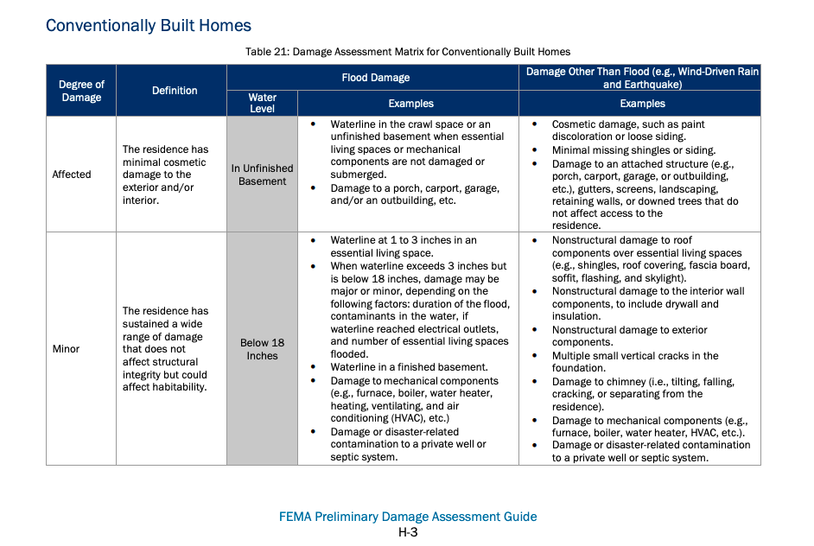
FEMA Classifications
When in doubt, select higher category

Slide 8
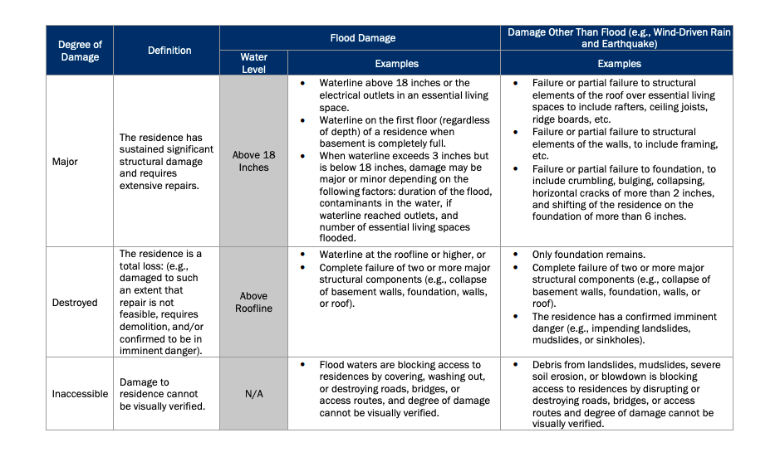
FEMA Classifications
When in doubt, select higher category

Slide 9
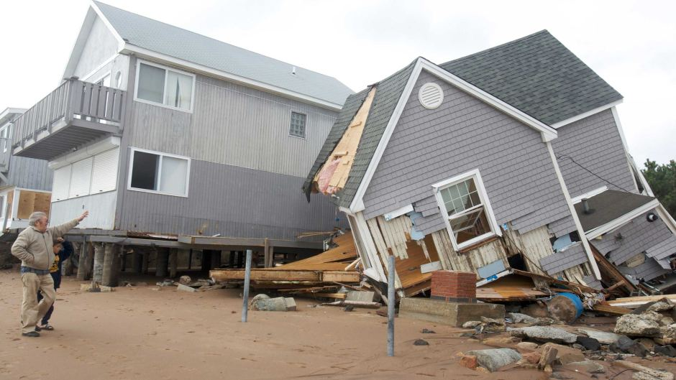
Name the Damage Category

Slide 10
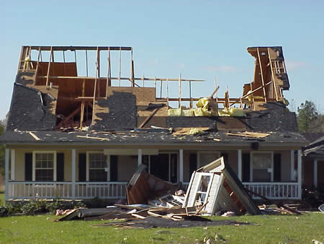
Name the Damage Category

Slide 11
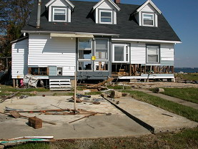
Name the Damage Category

Slide 12
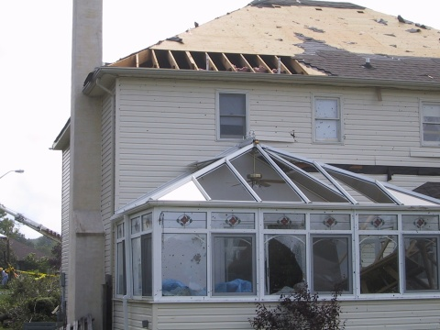
Name the Damage Category

Slide 13
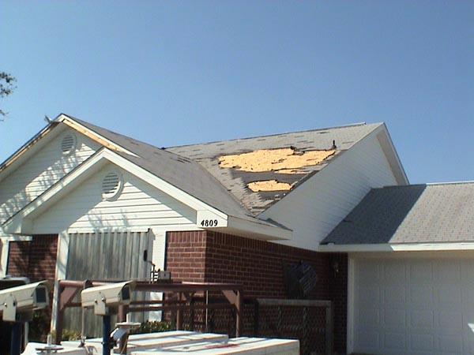
Name the Damage Category

Slide 14
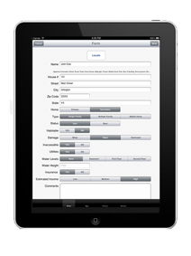
Crisis Track Components
Field Data
Collection
How This Works Together
Residential Structure
EOC Planning, Tracking
And Reporting
iOS, Android, or Windows 10
Console App
Commercial Structure

Slide 15
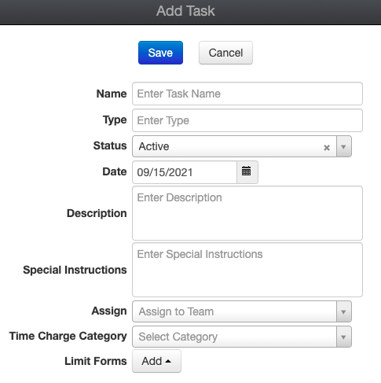
Tasks
Task – a collection of Entry Forms
- Organized by geographic area or type of activity

Slide 16
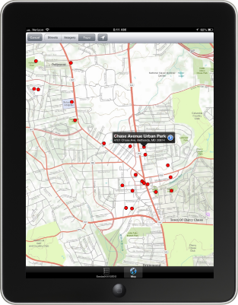
Demonstration
Initial Damage Report
Building Damage Assessments
Form —> Photos —> Save —> Save/Upload
Changing the Form Type
Adding a new Form

Slide 17
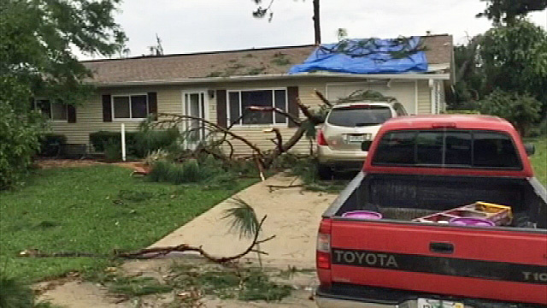
Exercise

Slide 18
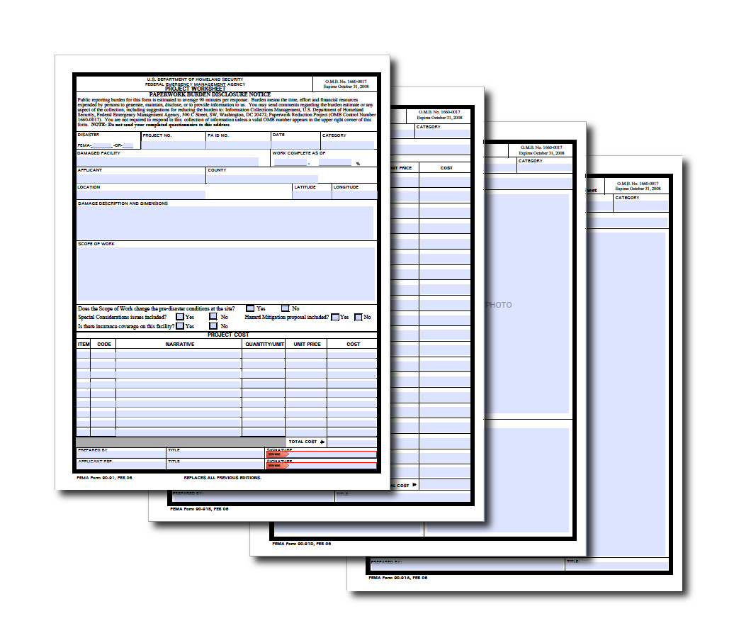
Reporting
Operations View
PDA Documents
VDEM View

Slide 19
Setup Disconnected Use
Download Standard Map
Download Structures
Start Button Functionality

Slide 20
Questions?
support@crisistrack.com
John Maylie
571-338-9925
johnmaylie@crisistrack.com

